Slide 1
CIS 530: Vector Semantics part 3
Jurafsky and Martin Chapter 6

Slide 2
Reminders
Homework 5 will be released then
No class on Wednesday
HW4 is due on Wednesday by 11:59pm

Slide 3
Recap: Vector Semantics
Embeddings = vector models of meaning
More fine-grained than just a string or index
Especially good at modeling similarity/analogy
Can use sparse models (tf-idf) or dense models (word2vec, GLoVE)
Just download them and use cosines!!
Distributional Information is key

Slide 4
What can we do with Distributional Semantics?
Historical and Socio-linguistics

Slide 5

Embeddings can help study word history!
Train embeddings on old books to study changes in word meaning!!
Dan Jurafsky
Will Hamilton
Notes:
Embeddings and Historical Semantics: Embeddings can also be a useful tool for studying how meaning changes over time, by computing multiple embedding spaces, each from texts written in a particular time period. For example Fig. 6.15 shows a visualization of changes in meaning in English words over the last two centuries, computed by building separate embedding spaces for each decade from historical corpora like Google N-grams (Lin et al., 2012) and the Corpus of Histori- cal American English (Davies, 2012).

Slide 6


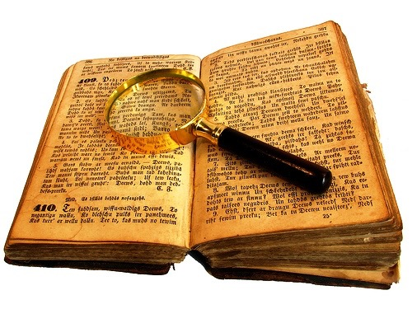
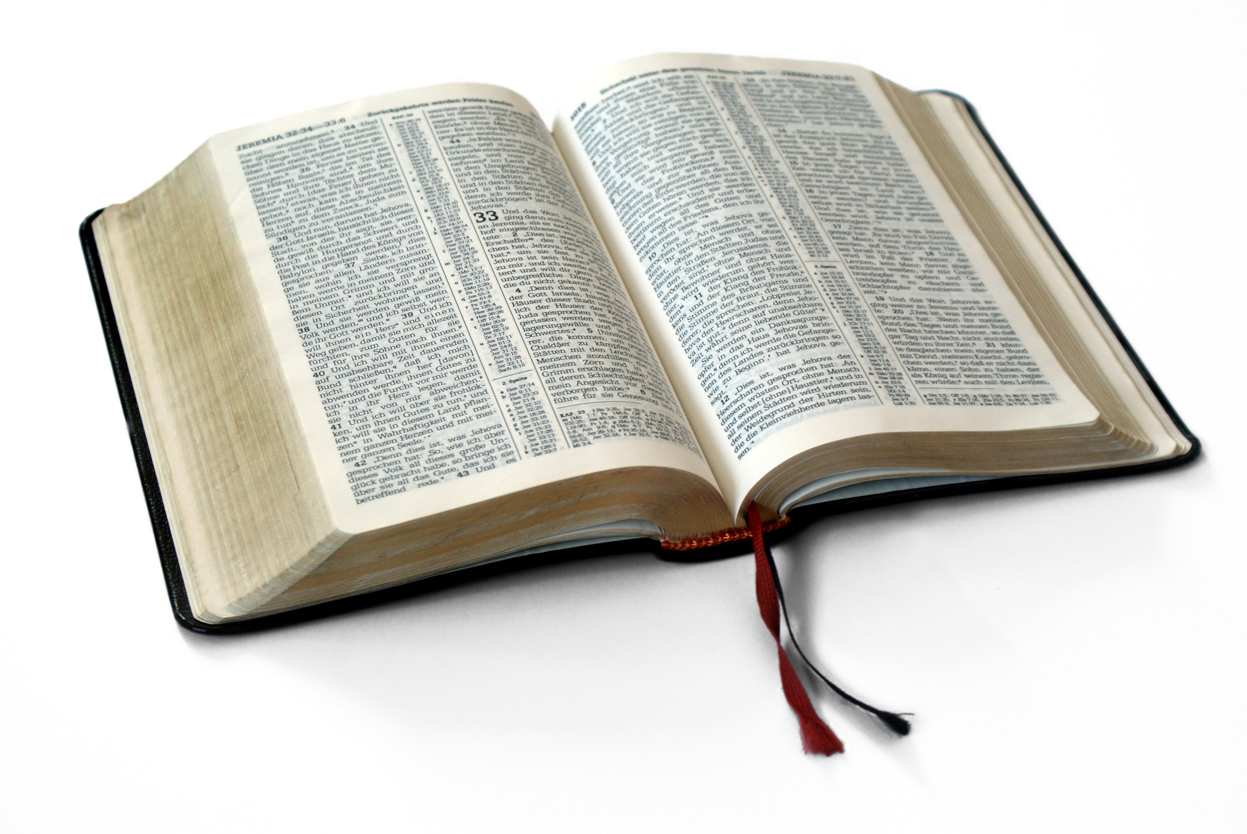
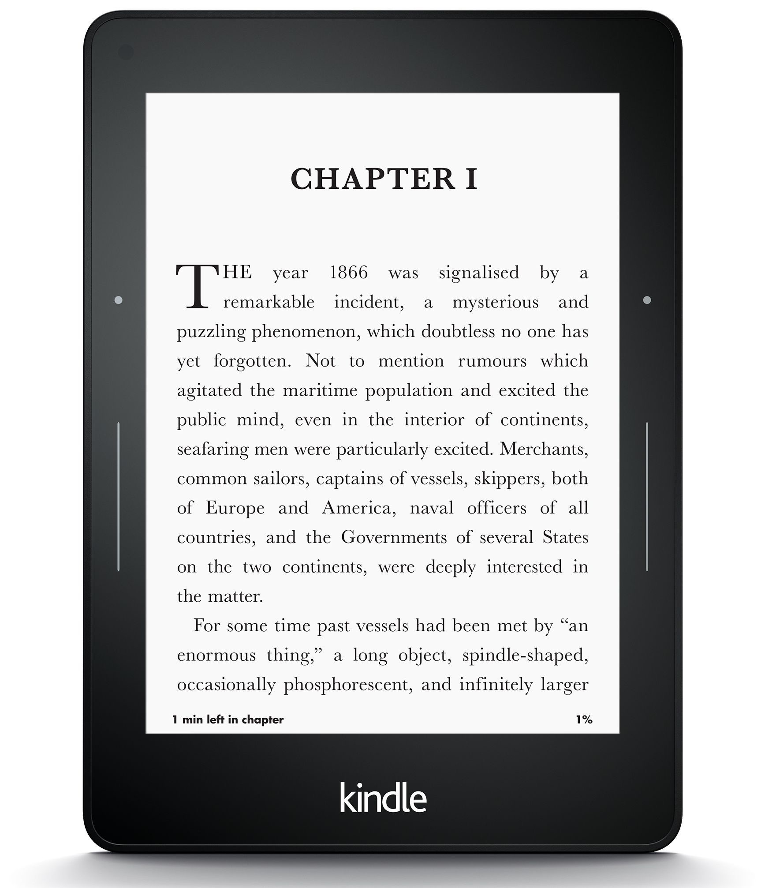
Diachronic word embeddings for studying language change
Word vectors for 1920
Word vectors 1990
“dog” 1990 word vector
“dog” 1920 word vector
vs.
1900
1950
2000
￼
￼
Notes:
di·a·chron·ic | ˌdīəˈkränik |
adjective
concerned with the way in which something, especially language, has developed and evolved through time. linguistic change is the diachronic aspect of linguistic variation.

Slide 7
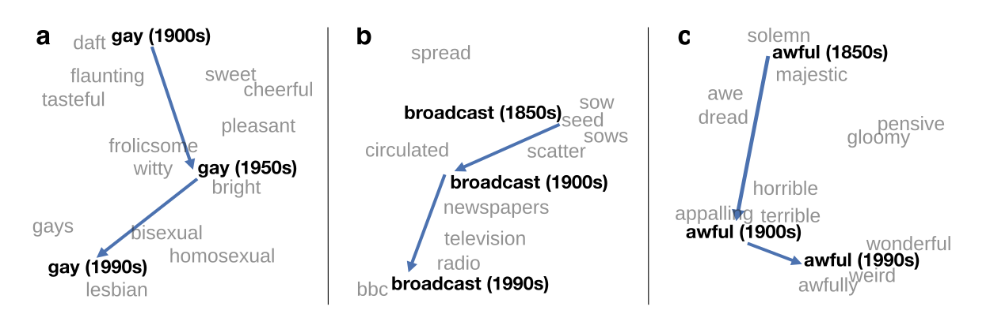
Visualizing changes
Project 300 dimensions down into 2
~30 million books, 1850-1990, Google Books data
Notes:
visualization of the semantic change of 3 words in English using
Figure 5à: Two-dimensional visualization of semantic change in English using SGNS word2vec vectors. The modern sense of each word, and the grey context words, are com-
vectors see Section 5à8 for the visualization algorithm à A, The word gay shifted puted from the most recent (modern) time-point embedding space. Earlier points are com-
from meaning ÒcheerfulÓ or ÒfrolicsomeÓ to referring to homosexualityà A, In the early puted from earlier historical embedding spaces. The visualizations show the changes in the
2àth century broadcast referred to Òcasting out seedsÓà with the rise of television and word gay from meanings related to “cheerful” or “frolicsome” to referring to homosexuality,
radio its meaning shifted to Òtransmitting signalsÓà C, Awful underwent a process of the development of the modern “transmission” sense of broadcast from its original sense of
pejoration, as it shifted from meaning Òfull of aweÓ to meaning Òterrible or appallingÓ
sowing seeds, and the pejoration of the word awful as it shifted from meaning “full of awe” t2om2eàaning “terrible or appalling”

Slide 8
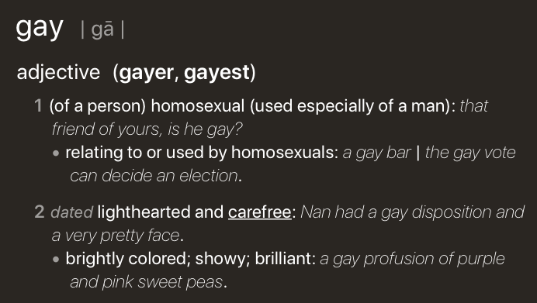
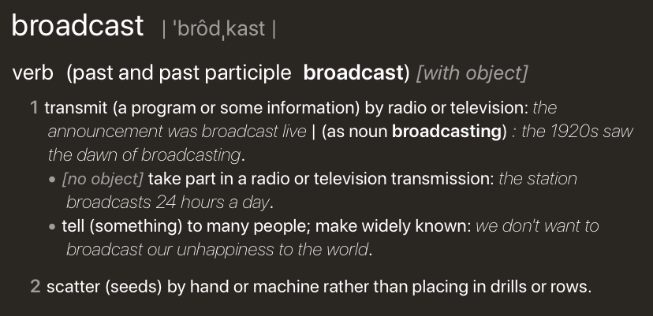
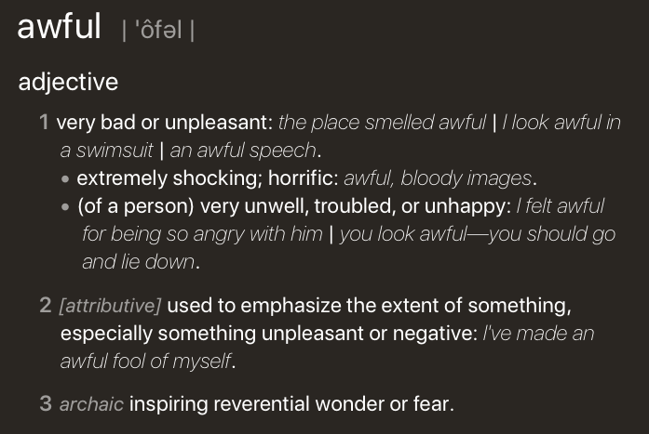
Visualizing changes
Project 300 dimensions down into 2
~30 million books, 1850-1990, Google Books data
Notes:
visualization of the semantic change of 3 words in English using
Figure 5à: Two-dimensional visualization of semantic change in English using SGNS word2vec vectors. The modern sense of each word, and the grey context words, are com-
vectors see Section 5à8 for the visualization algorithm à A, The word gay shifted puted from the most recent (modern) time-point embedding space. Earlier points are com-
from meaning ÒcheerfulÓ or ÒfrolicsomeÓ to referring to homosexualityà A, In the early puted from earlier historical embedding spaces. The visualizations show the changes in the
2àth century broadcast referred to Òcasting out seedsÓà with the rise of television and word gay from meanings related to “cheerful” or “frolicsome” to referring to homosexuality,
radio its meaning shifted to Òtransmitting signalsÓà C, Awful underwent a process of the development of the modern “transmission” sense of broadcast from its original sense of
pejoration, as it shifted from meaning Òfull of aweÓ to meaning Òterrible or appallingÓ
sowing seeds, and the pejoration of the word awful as it shifted from meaning “full of awe” t2om2eàaning “terrible or appalling”

Slide 9
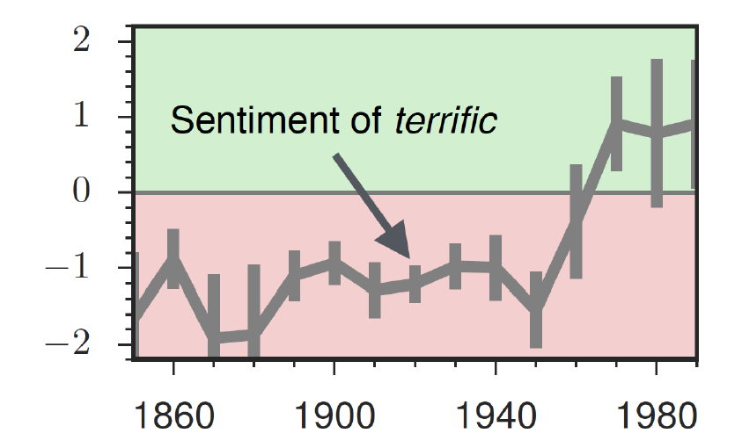
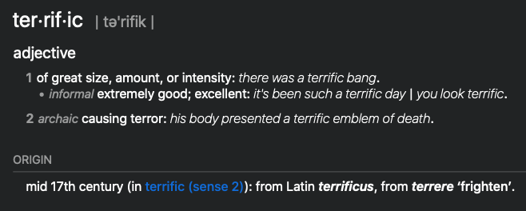
The evolution of sentiment words

Slide 10
Embeddings and bias
Notes:
In addition to their ability to learn word meaning from text, embeddings, alas, also
indicating surprise disbelief à
reproduce the implicit biases and stereotypes that were latent in the text. Recall that
embeddings model analogical relations; ‘queen’ as the closest word to ’king’ - ’man’
+ ’woman’ implies the analogy man:woman::king:queen. But embedding analogies 5à2à2 Computational linguistic studies
also exhibit gender stereotypes.

Slide 11
Embeddings reflect cultural bias
Bolukbasi, Tolga, Kai-Wei Chang, James Y. Zou, Venkatesh Saligrama, and Adam T. Kalai. "Man is to computer programmer as woman is to homemaker? debiasing word embeddings." In Advances in Neural Information Processing Systems, pp. 4349-4357. 2016.
Ask “Paris : France :: Tokyo : x”
x = Japan
Ask “father : doctor :: mother : x”
x = nurse
Ask “man : computer programmer :: woman : x”
x = homemaker
Notes:
For example Bolukbasi et al. (2016) find that the closest occupation to ‘man’ - ‘computer programmer’ + ‘woman’ in word2vec em-
There are also a number of recent works analyzing semantic change using computational
beddings trained on news text is ‘homemaker’, and that the embeddings similarly
methodsà 2àà use latent semantic analysis to analyze how word meanings broaden
suggest the analogy ‘father’ is to ‘doctor’ as ‘mother’ is to ‘nurse’. Algorithms that
and narrow over timeà 3 use raw co-occurrence vectors to perform a number of
used embeddings as part of an algorithm to search for potential programmers or
historical case-studies on semantic change, and 252 perform a similar set of small-
doctors might thus incorrectly downweight documents with women’s names.

Slide 12
Measuring cultural bias
Implicit Association test (Greenwald et al 1998): How associated are
concepts (flowers, insects) & attributes (pleasantness, unpleasantness)?
Studied by measuring timing latencies for categorization.
Psychological findings on US participants:
African-American names are associated with unpleasant words (more than European-American names)
Male names associated more with math, female names with arts
Old people's names with unpleasant words, young people with pleasant words.
Notes:
Roughly speaking, if humans associate ‘flowers’ with ’pleasantness’ and ‘insects’ with ‘unpleasant- ness’, when they are instructed to push a red button for ‘flowers’ (daisy, iris, lilac) and ’pleasant words’ (love, laughter, pleasure) and a green button for ‘insects’ (flea, spider, mosquito) and ‘unpleasant words’ (abuse, hatred, ugly) they are faster than in an incongruous condition where they push a red button for ‘flowers’ and ‘unpleasant words’ and a green button for ‘insects’ and ‘pleasant words
Embeddings also encode the implicit associations that are a property of human
scale case-studies using temporal topic modelsà 8à construct point-wise mutual
reasoning. The Implicit Association Test (Greenwald et al., 1998) measures peo- information-based embeddings and found that semantic changes uncovered by their
ple’s associations between concepts (like ’flowers’ or ’insects’) and attributes (like
method had reasonable agreement with human judgmentsà 29 and 9 use ÒneuralÓ
‘pleasantness’ and ‘unpleasantness’) by measuring differences in the latency with
word-embedding methods to detect linguistic change pointsà Finally, 25à analyze
which they label words in the various categories.6 Using such methods, people in the United States have been shown to associate African-American names with
historical co-occurrences to test whether synonyms tend to change in similar waysà
unpleasant words (more than European-American names), male names more with mathematics and female names with the arts, and old people’s names with unpleas- ant words (Greenwald et al. 1998, Nosek et al. 2002a, Nosek et al. 2002b). Caliskan et al. (2017) replicated all these findings of implicit associations using GloVe vec- tors and cosine similarity instead of human latencies. For example Afrian American names like ‘Leroy’ and ‘Shaniqua’ had a higher GloVe cosine with unpleasant words while European American names (‘Brad’, ‘Greg’, ‘Courtney’) had a higher cosine with pleasant words. Any embedding-aware algorithm that made use of word senti- ment could thus lead to bias against African Americans.

Slide 13
Embeddings reflect cultural bias
Aylin Caliskan, Joanna J. Bruson and Arvind Narayanan. 2017. Semantics derived automatically from language corpora contain human-like biases. Science 356:6334, 183-186.
Caliskan et al. replication with embeddings:
African-American names (Leroy, Shaniqua) had a higher GloVe cosine with unpleasant words (abuse, stink, ugly)
European American names (Brad, Greg, Courtney) had a higher cosine with pleasant words (love, peace, miracle)
Embeddings reflect and replicate all sorts of pernicious biases.
Notes:
Roughly speaking, if humans associate ‘flowers’ with ’pleasantness’ and ‘insects’ with ‘unpleasant- ness’, when they are instructed to push a red button for ‘flowers’ (daisy, iris, lilac) and ’pleasant words’ (love, laughter, pleasure) and a green button for ‘insects’ (flea, spider, mosquito) and ‘unpleasant words’ (abuse, hatred, ugly) they are faster than in an incongruous condition where they push a red button for ‘flowers’ and ‘unpleasant words’ and a green button for ‘insects’ and ‘pleasant words
Embeddings also encode the implicit associations that are a property of human
scale case-studies using temporal topic modelsà 8à construct point-wise mutual
reasoning. The Implicit Association Test (Greenwald et al., 1998) measures peo- information-based embeddings and found that semantic changes uncovered by their
ple’s associations between concepts (like ’flowers’ or ’insects’) and attributes (like
method had reasonable agreement with human judgmentsà 29 and 9 use ÒneuralÓ
‘pleasantness’ and ‘unpleasantness’) by measuring differences in the latency with
word-embedding methods to detect linguistic change pointsà Finally, 25à analyze
which they label words in the various categories.6 Using such methods, people in the United States have been shown to associate African-American names with
historical co-occurrences to test whether synonyms tend to change in similar waysà
unpleasant words (more than European-American names), male names more with mathematics and female names with the arts, and old people’s names with unpleas- ant words (Greenwald et al. 1998, Nosek et al. 2002a, Nosek et al. 2002b). Caliskan et al. (2017) replicated all these findings of implicit associations using GloVe vec- tors and cosine similarity instead of human latencies. For example Afrian American names like ‘Leroy’ and ‘Shaniqua’ had a higher GloVe cosine with unpleasant words while European American names (‘Brad’, ‘Greg’, ‘Courtney’) had a higher cosine with pleasant words. Any embedding-aware algorithm that made use of word senti- ment could thus lead to bias against African Americans.

Slide 14
Directions
Debiasing algorithms for embeddings
Bolukbasi, Tolga, Chang, Kai-Wei, Zou, James Y., Saligrama, Venkatesh, and Kalai, Adam T. (2016). Man is to computer programmer as woman is to homemaker? debiasing word embeddings. In Advances in Neural Infor- mation Processing Systems, pp. 4349–4357.
Use embeddings as a historical tool to study bias

Slide 15
Embeddings as a window onto history
Nikhil Garg, Londa Schiebinger, Dan Jurafsky, and James Zou, (2018). Word embeddings quantify 100 years of gender and ethnic stereotypes. Proceedings of the National Academy of Sciences, 115(16), E3635–E3644
Use the Hamilton historical embeddings
The cosine similarity of embeddings for decade X for occupations (like teacher) to male vs female names
Is correlated with the actual percentage of women teachers in decade X

Slide 16
History of biased framings of women
Nikhil Garg, Londa Schiebinger, Dan Jurafsky, and James Zou, (2018). Word embeddings quantify 100 years of gender and ethnic stereotypes. Proceedings of the National Academy of Sciences, 115(16), E3635–E3644
Embeddings for competence adjectives are biased toward men
Smart, wise, brilliant, intelligent, resourceful, thoughtful, logical, etc.
This bias is slowly decreasing

Slide 17
Princeton Trilogy experiments
Study 1: Katz and Braley (1933)
Investigated whether traditional social stereotypes had a cultural basis
Ask 100 male students from Princeton University to choose five traits that characterized different ethnic groups (for example Americans, Jews, Japanese, Negroes) from a list of 84 word
84% of the students said that Negroes were superstitious and 79% said that Jews were shrewd. They were positive towards their own group.
Study 2: Gilbert (1951) Less uniformity of agreement about unfavorable traits than in 1933.
Study 3: Karlins et al. (1969)
Many students objected to the task but this time there was greater agreement on the stereotypes assigned to the different groups compared with the 1951 study. Interpreted as a re-emergence of social stereotyping but in the direction more favorable stereotypical images.
Notes:
Study 1: Katz and Braley (1933)
Investigated whether traditional social stereotypes had a cultural basis by asking 100 male students from Princeton University to choose five traits that characterized different ethnic groups (for example Americans, Jews, Japanese, Negroes) from a list of 84 words. The results showed considerable agreement in stereotypes, especially of negative traits. Eighty-four per cent of the students said that Negroes were superstitious and 79% said that Jews were shrewd. They were very positive towards their own group (ingroup bias). Since most of the students did not have any personal contact with members of the ethnic groups they had to rate, it was suggested that stereotypes are learned (e.g. through the media or by gatekeepers, i.e. they are cultural products).
Study 2: Gilbert (1951)
Replicated the study of Princeton students. This time there was less uniformity of agreement, especially about unfavorable traits, than in the 1933 study. The stereotypes still demonstrated an ingroup bias. Stereotypes about Japanese were extremely negative and this was explained by the negative press about Japan after Pearl Harbor, so the original hypothesis about stereotypes as cultural products was confirmed. Many students expressed irritation at being asked to make generalizations at all and this could indicate a social change (e.g. that it was no longer as acceptable to express stereotypes openly).
Study 3: Karlins et al. (1969)
Replicated the study. Many students objected to the task but this time there was greater agreement on the stereotypes assigned to the different groups compared with the 1951 study. The researchers interpreted this as a re-emergence of social stereotyping but in the direction of a more favorable stereotypical image.

Slide 18
Embeddings reflect ethnic stereotypes over time
Nikhil Garg, Londa Schiebinger, Dan Jurafsky, and James Zou, (2018). Word embeddings quantify 100 years of gender and ethnic stereotypes. Proceedings of the National Academy of Sciences, 115(16), E3635–E3644
Princeton trilogy experiments
Attitudes toward ethnic groups (1933, 1951, 1969) scores for adjectives
industrious, superstitious, nationalistic, etc
Cosine of Chinese name embeddings with those adjective embeddings correlates with human ratings.
Notes:
Study 1: Katz and Braley (1933)
Investigated whether traditional social stereotypes had a cultural basis by asking 100 male students from Princeton University to choose five traits that characterized different ethnic groups (for example Americans, Jews, Japanese, Negroes) from a list of 84 words. The results showed considerable agreement in stereotypes, especially of negative traits. Eighty-four per cent of the students said that Negroes were superstitious and 79% said that Jews were shrewd. They were very positive towards their own group (ingroup bias). Since most of the students did not have any personal contact with members of the ethnic groups they had to rate, it was suggested that stereotypes are learned (e.g. through the media or by gatekeepers, i.e. they are cultural products).
Study 2: Gilbert (1951)
Replicated the study of Princeton students. This time there was less uniformity of agreement, especially about unfavorable traits, than in the 1933 study. The stereotypes still demonstrated an ingroup bias. Stereotypes about Japanese were extremely negative and this was explained by the negative press about Japan after Pearl Harbor, so the original hypothesis about stereotypes as cultural products was confirmed. Many students expressed irritation at being asked to make generalizations at all and this could indicate a social change (e.g. that it was no longer as acceptable to express stereotypes openly).
Study 3: Karlins et al. (1969)
Replicated the study. Many students objected to the task but this time there was greater agreement on the stereotypes assigned to the different groups compared with the 1951 study. The researchers interpreted this as a re-emergence of social stereotyping but in the direction of a more favorable stereotypical image.

Slide 19
Change in linguistic framing 1910-1990
Nikhil Garg, Londa Schiebinger, Dan Jurafsky, and James Zou, (2018). Word embeddings quantify 100 years of gender and ethnic stereotypes. Proceedings of the National Academy of Sciences, 115(16), E3635–E3644
Change in association of Chinese names with adjectives framed as "othering" (barbaric, monstrous, bizarre)
Notes:
This shows the relative strength of the Asian association for words used to describe outsiders over time. As opposed to the adjectives overall, which see two distinct phase shifts in Asian association, the words related to outsiders steadily decrease in Asian association over time—except around World War II—indicating that broader globalization trends led to changing attitudes with regard to such negative portrayals. Overall, the word embeddings exhibit a remarkable change in adjectives and attitudes toward Asian Americans during the 20th century.

Slide 20
Changes in framing: adjectives associated with Chinese
Nikhil Garg, Londa Schiebinger, Dan Jurafsky, and James Zou, (2018). Word embeddings quantify 100 years of gender and ethnic stereotypes. Proceedings of the National Academy of Sciences, 115(16), E3635–E3644

Slide 21
What should a semantic model be able to do?
Goals for Distributional Semantics
Notes:
1. A semantic model should capture how language relates to the world via sensory perception (grounding)
2. A semantic model should be able to generalize to new situations (connecting concepts, referents, and logical denotations)
3. A semantic model should robustly hand vagueness (situations when it is unclear whether an entity is a referent of a concept)
4. A semantic model should handle words with multiple senses (polysemy) and encode relationships like hyponym between words/word senses
5. Word representations should be able to be combined to encode the meanings of sentences (compositionally) through a better process than component wise multiplication (which is commutative and therefore loses word order)
6. A semantic model should support local notions of truth and entailment (one proposition follows from another).
7. A semantic model should be able to capture how word meaning depends on context.

Slide 22
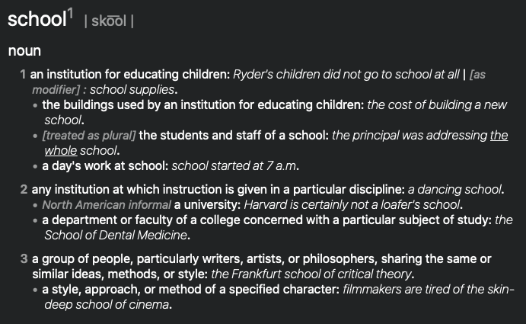

Goal: Word Sense
The meaning of a word can often be broken up into distinct senses. Sometimes we describe these words as polysemous or homonymous
Notes:
1. A semantic model should capture how language relates to the world via sensory perception (grounding)
2. A semantic model should be able to generalize to new situations (connecting concepts, referents, and logical denotations)
3. A semantic model should robustly hand vagueness (situations when it is unclear whether an entity is a referent of a concept)
4. A semantic model should handle words with multiple senses (polysemy) and encode relationships like hyponym between words/word senses
5. Word representations should be able to be combined to encode the meanings of sentences (compositionally) through a better process than component wise multiplication (which is commutative and therefore loses word order)
6. A semantic model should support local notions of truth and entailment (one proposition follows from another).
7. A semantic model should be able to capture how word meaning depends on context.

Slide 23
Goal: Word Sense
Do the vector based representations of words that we’ve looked at so far handle word sense well?

Slide 24
Goal: Word Sense
Do the vector based representations of words that we’ve looked at so far handle word sense well? No! All senses of a word are collapsed into the same word vector.
One solution would be to learn a separate representation for each sense. However, it is hard to enumerate a discrete set of senses for a word.
A good semantic model should be able to automatically capture variation in meaning without a manually specified sense inventory.
Notes:
One solution is to learn a separate representation
However, deciding on a discrete set of senses is difficult, and practical fforts at compiling dictionaries have not provided a solution. Indeed, the lexicographer Sue Atkins bluntly stated, “I don’t believe in word senses”.

Slide 25
Goal: Word Sense
Clustering Paraphrases by Word Sense. Anne Cocos and Chris Callison-Burch. NAACL 2016.

Slide 26
Goal: Hypernomy
One goal of for a semantic model is to represent the relationship between words. A classic relation is hypernomy which describes when one word (the hypernym) is more general than the other word (the hyponym).

Slide 27
Goal: Hypernomy
The Distributional Inclusion Hypotheses and Lexical Entailment. Maayan Geffet and Ido Dagan. ACL 2005.
Distributional inclusion hypotheses, which correspond to the two directions of inference relating distributional feature inclusion and lexical entailment. Let vi and wj be two word senses of words w and v, and let vi => wj denote the (directional) entailment relation between these senses. Assume further that we have a measure that determines the set of characteristic features for the meaning of each word sense. Then we would hypothesize:
Hypothesis I:
If vi => wj then all the characteristic features of vi are expected to appear with wj.
Hypothesis II:
If all the characteristic features of vi appear with wj then we expect that vi => wj.
Notes:
Distributional Inclusion Hypothesis (DIH) states that a hyperonym occurs in all the contexts of its hyponyms.

Slide 28
Goal: Hypernomy
Distributional Lexical Entailment by Topic Coherence. Laura Rimell. EACL 2014.
Distributional Inclusion Hypothesis (DIH) states that a hyperonym occurs in all the contexts of its hyponyms.
For example, lion is a hyponym of animal, but mane is a likely context of lion and unlikely for animal, contradicting the DIH.
Rimell proposes measuring hyponymy using coherence: the contexts of a general term minus those of a hyponym are coherent, but the reverse is not true.

Slide 29
Goal: Hypernomy
Order Embeddings of Images and Language. Ivan Vendrov, Ryan Kiros, Sanja Fidler, Raquel Urtasun. ICLR 2016.
Vendrovet al. (2016) use non-negative vectors, where one vector is a hyponym of another if it has a larger value in every dimension.

Slide 30
Goal: Compositionality
Language is productive. We can understand completely new sentences, as long as we know each word in the sentence. One goal for a semantic model is to be able to derive the meaning of a sentence from its parts, so that we can generalize to new combinations. This is known as compositionality.

Slide 31
Goal: Compositionality
Vector-based models of semantic composition. Jeff Mitchell and Mirella Lapata. ACL 2010.
For vector space models, we have the challenge of how to compose word vectors to construct phrase representation. One option is to represent phrases as vectors too.
If we use the same vector space as for words, the challenge is then to find a composition function that maps a pair of vectors onto a new vectors.
Mitchell and Lapata experimented with a variety of functions and found that component-wise multiplication was as good or better than other functions that they tried.

Slide 32
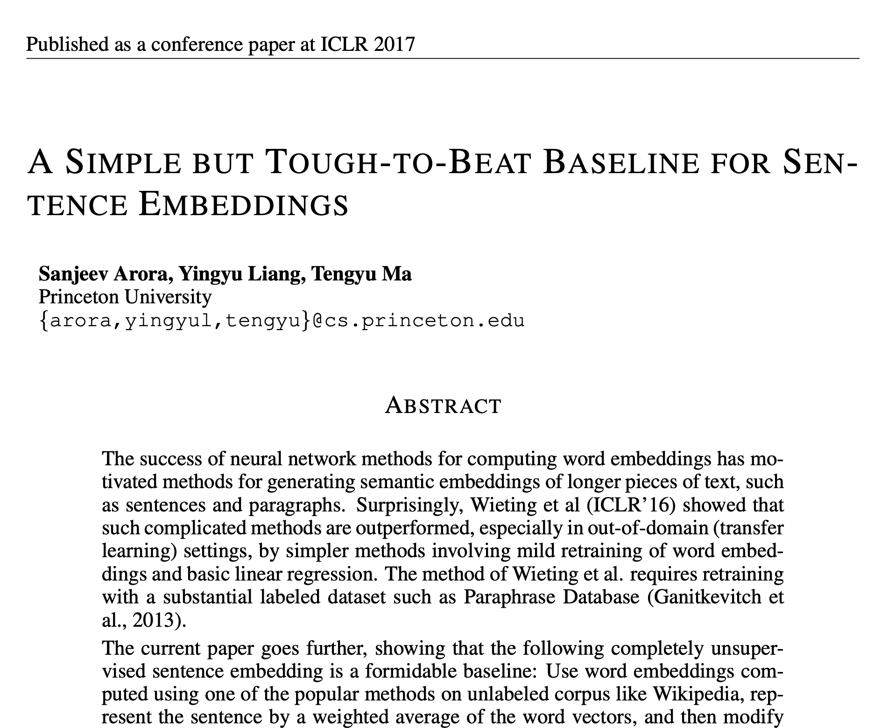

Slide 33
Goal: Compositionality
Vector-based models of semantic composition. Jeff Mitchell and Mirella Lapata. ACL 2010.
The problem with componentwise multiplication is that it is commutative and therefore insensitive to word order.
These two sentences contain exactly the same words, but they do not have the same meaning:
It was not the sales manager who hit the bottle that day, but the office worker with the serious drinking problem.
hat day the office manager, who was drinking, hit the problem sales worker with a bottle, but it was not serious.

Slide 34
Goal: Grounding
A semantic model should capture how language relates to the world via sensory perception and motor control.
The process of connecting language to the world is called grounding.
Vector space models that rely entirely on how words co-occur with other words is not grounded, since they are constructed solely from text.
Notes:
1. A semantic model should capture how language relates to the world via sensory perception (grounding)
2. A semantic model should be able to generalize to new situations (connecting concepts, referents, and logical denotations)
3. A semantic model should robustly hand vagueness (situations when it is unclear whether an entity is a referent of a concept)
4. A semantic model should handle words with multiple senses (polysemy) and encode relationships like hyponym between words/word senses
5. Word representations should be able to be combined to encode the meanings of sentences (compositionally) through a better process than component wise multiplication (which is commutative and therefore loses word order)
6. A semantic model should support local notions of truth and entailment (one proposition follows from another).
7. A semantic model should be able to capture how word meaning depends on context.

Slide 35
Goal: Grounding
Yansong Feng and Mirella Lapata (2010). Visual Information in Semantic Representation. Proceedings of NAACL.
Many experimental studies in language acquisition suggest that word meaning arises not only from exposure to the linguistic environment but also from our interaction with the physical world. Use collections of documents that contain pictures

Slide 36
Goal: Grounding
Yansong Feng and Mirella Lapata (2010). Visual Information in Semantic Representation. Proceedings of NAACL.
Many experimental studies in language acquisition suggest that word meaning arises not only from exposure to the linguistic environment but also from our interaction with the physical world. Use collections of documents that contain pictures
Notes:
Image partitioned into regions of varying granularity using (a) the normalized cut image segmentation algo- rithm, (b) uniform grid segmentation, and (c) the SIFT point detector.

Slide 37
Goal: Grounding
Elia Bruni, Giang Binh Tran, Marco Baroni (2011). Distributional semantics from text and images. Proceedings of the GEMS 2011 Workshop on GEometrical Models of Natural Language Semantics
How can we ground a distributional semantic model? Simplest way train word vectors, and then concatenate them with image vectors.

Slide 38
Goal: Grounding
Learning Translations via Images with a Massively Multilingual Image Dataset. John Hewitt*, Daphne Ippolito*, Brendan Callahan, Reno Kriz, Derry Wijaya and Chris Callison-Burch. ACL 2018
Notes:
Our dataset and approach allow translations to be discovered by comparing the images associated with foreign and English words. Shown here are five images for the Indone- sian word kucing, a word with high predicted concreteness, along with its top 4 ranked translations using CNN features.

Slide 39
Goal: Logical inference
Recognizing Textual Entailment: Models and Applications. Ido Dagan, Dan Roth, Mark Sammons, Fabio Massimo Zanzotto. Synthesis Lectures on Human Language Technologies, 2013.
Sentences can express complex thoughts and build change of reasoning. Logic formalize this. One goal of semantic models is to support the logical notions of truth and of entailment.
Vectors do not have logical structure, but they can be used in a system that computes entailment. One challenge problem that is proposed for NLU is the task of recognizing textual entailment.

Slide 40
Goal: Context Dependence
One goal of a semantic model is to capture how meaning depends on context. For example, a small elephant is not a small animal, but a large ant is. The meanings of small and large depend on the nouns that they modify.
Similarly performing word sense disambiguation requires understanding how a word is used in context.
The KGB planted a bug in the Oval Office.
I found a bug swimming in my soup.
Recent large language models like ELMo and BERT create different vectors for words depending on the sentences that they appear in.

Slide 41
A semantic model should
Handle words with multiple senses (polysemy) and encode relationships like hyponym between words/word senses
Robustly handle vagueness (situations when it is unclear whether an entity is a referent of a concept)
Should be able to be combined word representations to encode the meanings of sentences (compositionally)
Capture how word meaning depends on context.
Support logical notions of truth and entailment
Generalize to new situations (connecting concepts and referents)
Capture how language relates to the world via sensory perception (grounding)

